Slide 1
Election Algorithms
Many distributed algorithms such as mutual exclusion and deadlock detection require a coordinator process.
When the coordinator process fails, the distributed group of processes must execute an election algorithm to determine a new coordinator process.
Election Algorithms
1. Bully Algorithm
2. Ring Algorithm
These algorithms will assume that each active process has a unique priority id.

Slide 2
The Bully Algorithm
When any process, P, notices that the coordinator is no longer responding it initiates an election:
P sends an election message to all processes with higher id numbers.
If no one responds, P wins the election and becomes coordinator.
If a higher process responds, it takes over. Process P’s job is done.

Slide 3
The Bully Algorithm
At any moment, a process can receive an election message from one of its lower-numbered colleagues.
The receiver sends an OK back to the sender and conducts its own election.
Eventually only the bully process remains. The bully announces victory to all processes in the distributed group.

Slide 4
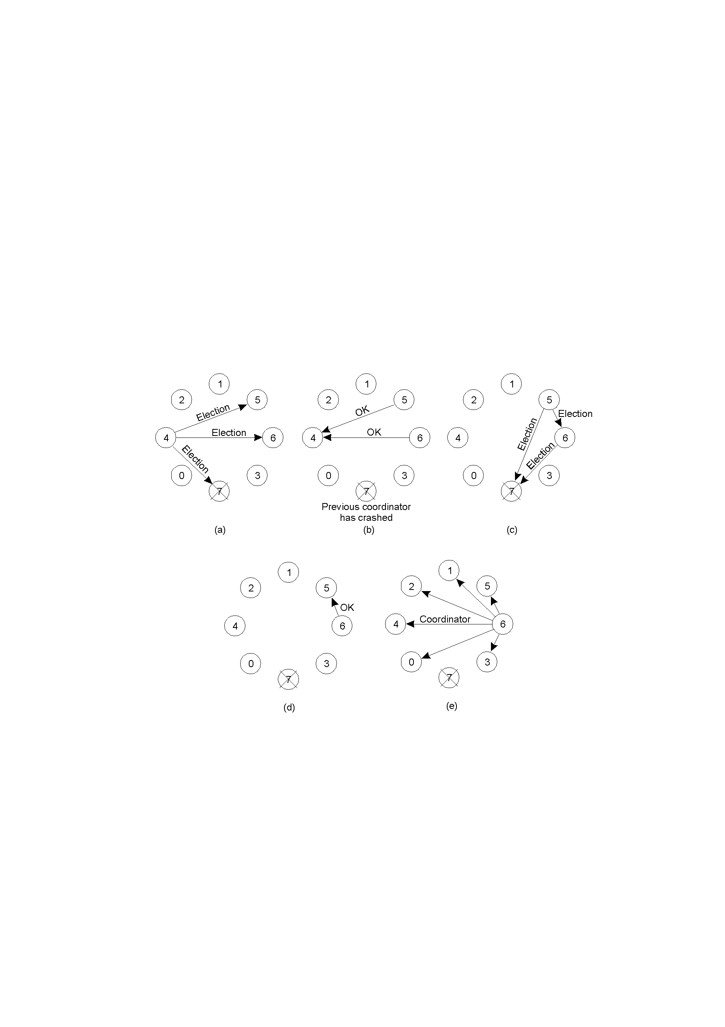
Bully Algorithm Example
Process 4 notices 7 down.
Process 4 holds an election.
Process 5 and 6 respond, telling 4 to stop.
Now 5 and 6 each hold an election.

Slide 5
Bully Algorithm Example
Process 6 tells process 5 to stop.
Process 6 (the bully) wins and tells everyone.
If processes 7 comes up, starts elections again.

Slide 6
A Ring Algorithm
Assume the processes are logically ordered in a ring {implies a successor pointer and an active process list} that is unidirectional.
When any process, P, notices that the coordinator is no longer responding it initiates an election:
1. P sends message containing P’s process id to the next available successor.

Slide 7
A Ring Algorithm
2. At each active process, the receiving process adds its process number to the list of processes in the message and forwards it to its successor.
3. Eventually, the message gets back to the sender.
4. The initial sender sends out a second message letting everyone know who the coordinator is {the process with the highest number} and indicating the current members of the active list of processes.

Slide 8
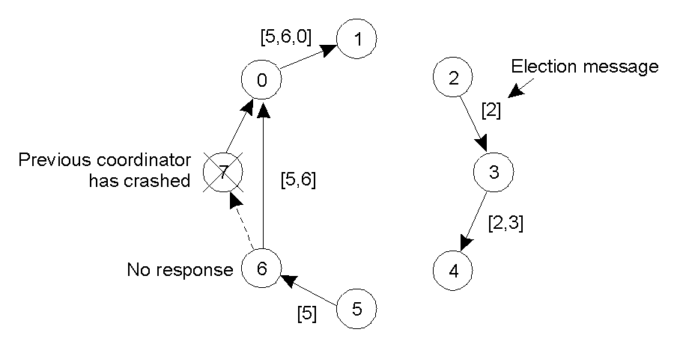
A Ring Algorithm
Even if two ELECTIONS start at once, everyone will pick the same leader.

